Slide 1
19CSE305: MACHINE LEARNING

Slide 2
Curse of Dimensionality
The number of input variables or features for a dataset is referred to as its dimensionality.
We can consider the columns of data representing dimensions on an n-dimensional feature space and the rows of data as points in that space
Having a large number of dimensions in the feature space can mean that the volume of that space is very large, and in turn, the points that we have in that space (rows of data) often represent a small and non-representative sample.

Slide 3
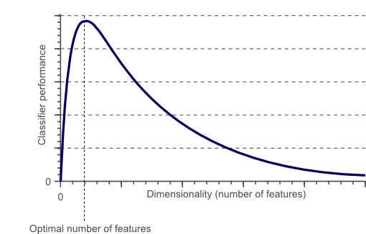
Curse of Dimensionality
It means that the error increases with the increase in the number of features.
It refers to the fact that algorithms are harder to design in high dimensions and often have a running time exponential in the dimensions

Slide 4
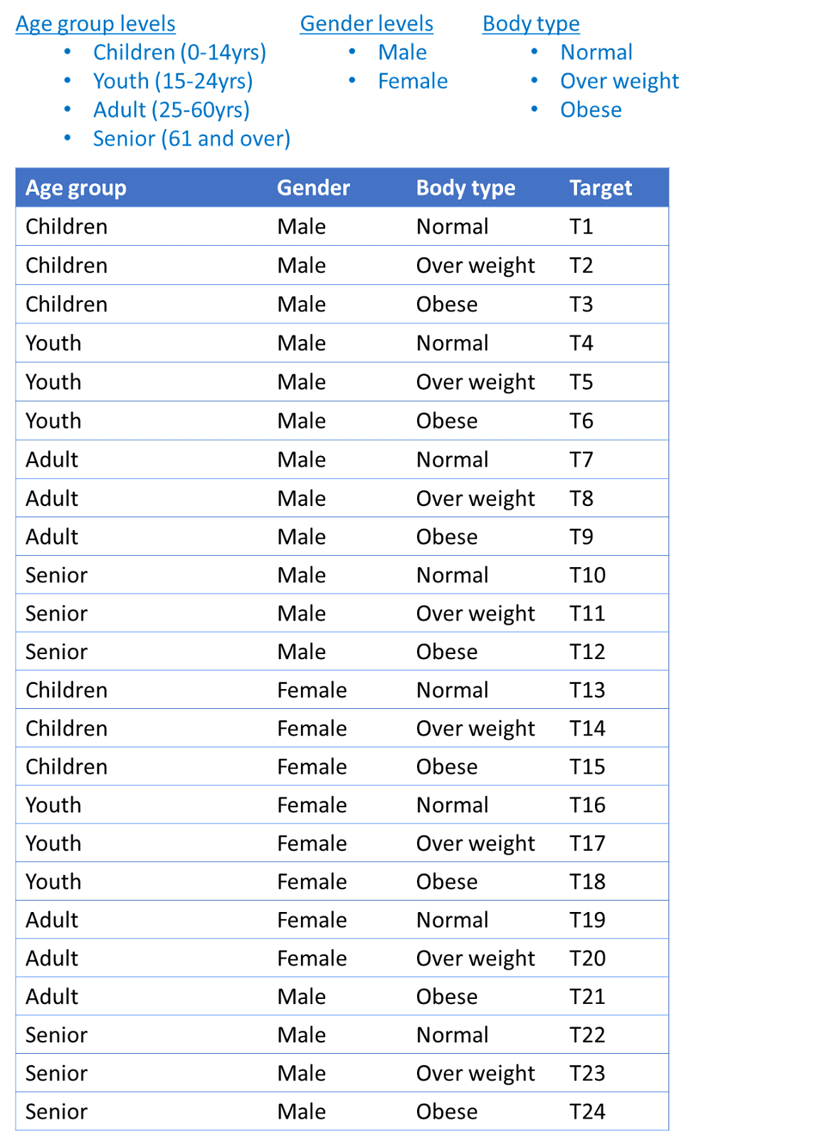
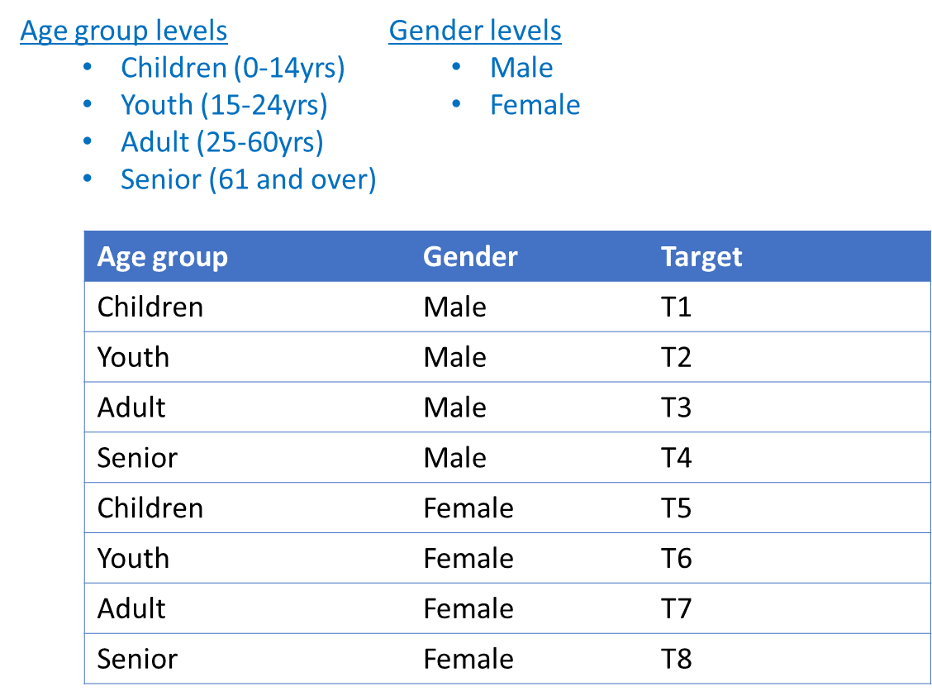
Curse of Dimensionality
Data Sparsity
As the number of attributes or the dimensions increases, the number of training samples required to generalize a model also increase phenomenally.

Slide 5
Curse of Dimensionality
As the number of features increases, the model becomes more complex.
The more the number of features, the more the chances of overfitting.
A machine learning model that is trained on a large number of features, gets increasingly dependent on the data it was trained on and in turn overfitted, resulting in poor performance on real data, beating the purpose.
Avoiding overfitting is a major motivation for performing dimensionality reduction.

Slide 6
Dimensionality Reduction
The main idea: reduce the dimensionality of the space.
Project the d-dimensional points in a k-dimensional space so that:
k << d
distances are preserved as well as possible
Solve the problem in low dimensions

Slide 7
Why Dimensionality Reduction
Decreasing d also decreases the complexity of the inference algorithm during testing.
When an input is decided to be unnecessary, we save the cost of extracting it.
When data can be explained with fewer features, we get a better idea about the data and knowledge extraction.
When data can be represented in a few dimensions without loss of information, it can be plotted and analyzed visually for structure and outliers.

Slide 8
Dimensionality Reduction
Avoiding overfitting is a major motivation for performing dimensionality reduction.
Feature Selection: identifying relevant features by correlation/ covariance analysis
Feature Engineering: generating new features from existing features, by applying some transformations

Slide 9
Feature Selection
Automatic Feature Selection
Also known as attribute selection
The process with the help of which we select those features in our data that are most relevant to the output or prediction variable in which we are interested.
Methods:
Low Variance filter
High Correlation filter.
Multicollinearity.
Feature Ranking.
Forward selection

Slide 10
Feature Engineering
New features are extracted as a linear combination of existing features.
Methods:
Principle Component Analysis (PCA)
Singular Value Decomposition (SVD)
Linear Discriminant Analysis (LDA)

Slide 11
Principal Component Analysis Encoding

Slide 12
Principal Component Analysis
Principal Component Analysis, or PCA, is a dimensionality-reduction method
Used to reduce the dimensionality of large data sets: by transforming a large set of variables into a smaller one that still contains most of the information in the large set
WHY?
Smaller data sets are easier to explore and visualize
Analyzing data become easier and faster for ML algorithms.
PCA— reduce the number of variables of a data set, while preserving as much information as possible.

Slide 13
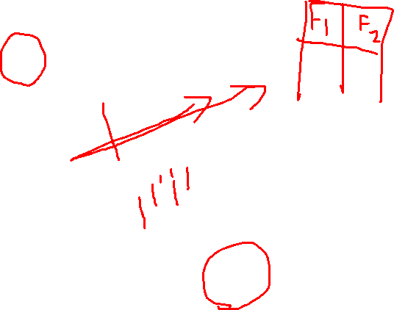
Principal Component Analysis
Intuition: find the axis that shows the greatest variation, and project all points into this axis
f2
e1
e2
f1

Slide 14
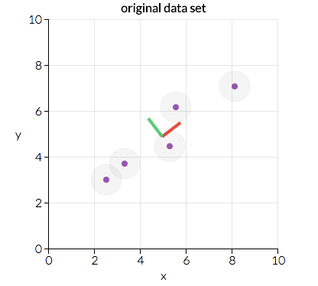
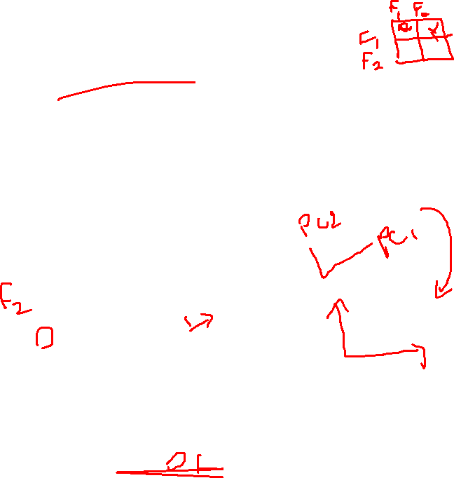
How does PCA work?
Step 1: We are going to calculate a matrix that summarizes how our variables all relate to one another.
Step 2: Break this matrix down into two separate components: direction and magnitude. We can then understand the “directions” of our data and its “magnitude” (or how “important” each direction is).

Slide 15
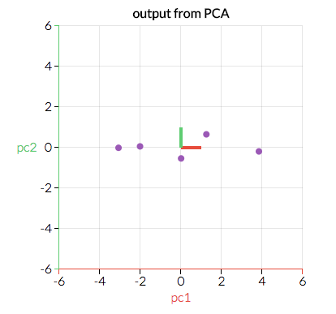

How does PCA work?
Step 3: Transform the original data to align with these important directions (which are combinations of the original variables).
By identifying which “directions” are most “important,” we can compress or project our data into a smaller space by dropping the “directions” that are the “least important.” – Dimensionality Reduction

Slide 16

PCA-algorithm
STEP 1: STANDARDIZATION
STEP 2: COVARIANCE MATRIX COMPUTATION
STEP 3: COMPUTE THE EIGENVECTORS AND EIGENVALUES OF THE COVARIANCE MATRIX TO IDENTIFY THE PRINCIPAL COMPONENTS
STEP 4: FEATURE VECTOR
STEP 5: RECAST THE DATA ALONG THE PRINCIPAL COMPONENTS AXES

Slide 17

PCA-algorithm
STEP 1: STANDARDIZATION
Standardize the range of the continuous initial variables so that each one of them contributes equally to the analysis.
PCA is quite sensitive regarding the variances of the initial variables
If there are large differences between the ranges of initial variables, those variables with larger ranges will dominate over those with small ranges (For example, a variable that ranges between 0 and 100 will dominate over a variable that ranges between 0 and 1)

Slide 18

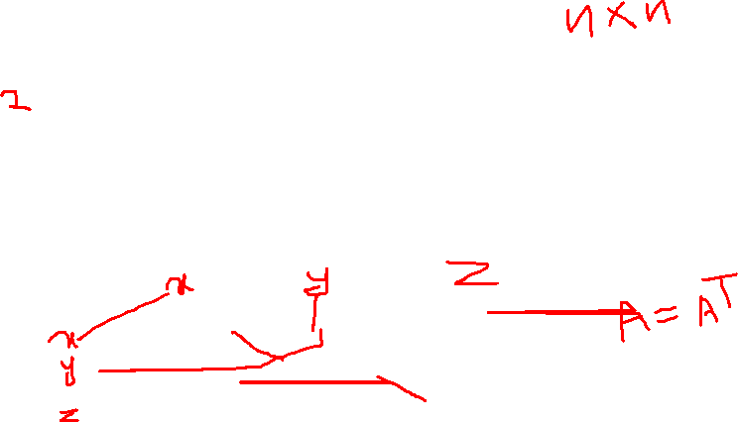
PCA-algorithm
STEP 1: COVARIANCE MATRIX COMPUTATION
To understand how the variables of the input data set are varying from the mean with respect to each other.
The covariance matrix is a p × p symmetric matrix (where p is the number of dimensions) that has as entries the covariances associated with all possible pairs of the initial variables
Why Symmetric?
Cov(a,a)=Var(a)
Main diagonal (Top left to bottom right) -variances of each initial variable
Cov(a,b)=Cov(b,a)
Covariance is commutative

Slide 19
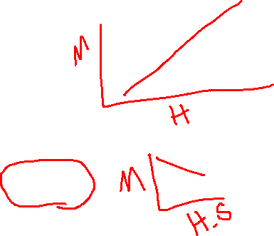
PCA-algorithm
What does covariance convey?
What is the interpretation of covariance calculations?
e.g.: 2 dimensional data set
x: number of hours studied for a subject
y: marks obtained in that subject
covariance value is say: 104.53
what does this value mean?
Exact value is not as important as it’s sign.
A positive value of covariance indicates : both dimensions increase or decrease together e.g. as the number of hours studied increases, the marks in that subject increase.
A negative value indicates: while one increases the other decreases, or vice-versa e.g. active social life vs performance in CS dept.
If covariance is zero: the two dimensions are independent of each other e.g. heights of students vs the marks obtained in a subject

Slide 20
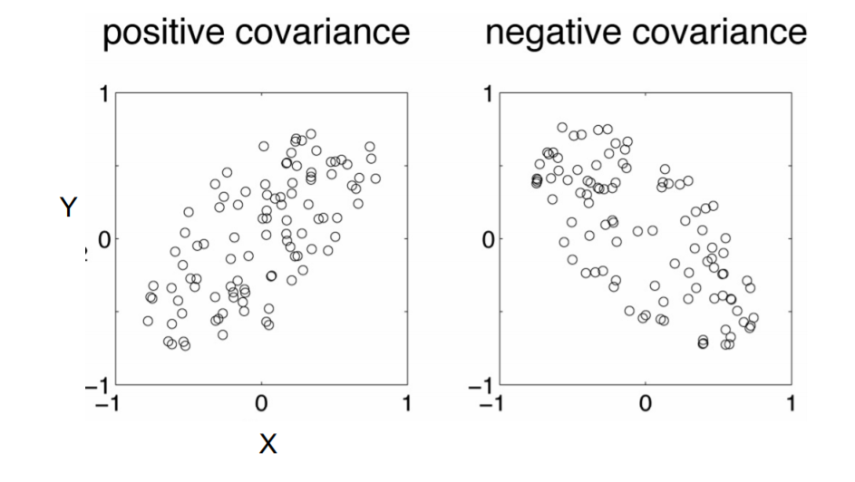

Slide 21
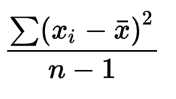

Var(X)=

Slide 22
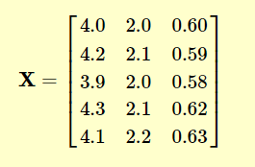
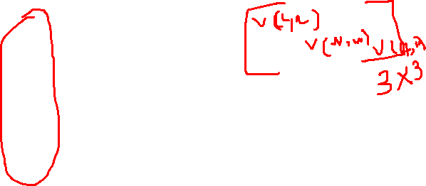
Calculate the covariance matrix for the following data.
L
W
H
The set of 5 observations, measuring 3 variables [length, width, and height of a certain object]

Slide 23

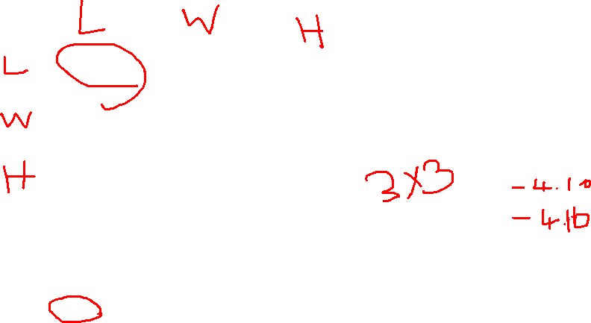
Cov(L,L) | Cov(L,W) | Cov(L,H)
Cov(W,L) | Cov(W,W) | Cov(W,H)
Cov(H,L) | Cov(H,W) | Cov(H,H)

Slide 24
0.025 | Cov(L,W) | Cov(L,H)
Cov(W,L) | Cov(W,W) | Cov(W,H)
Cov(H,L) | Cov(H,W) | Cov(H,H)

Slide 25
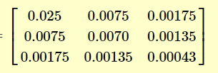

Slide 26
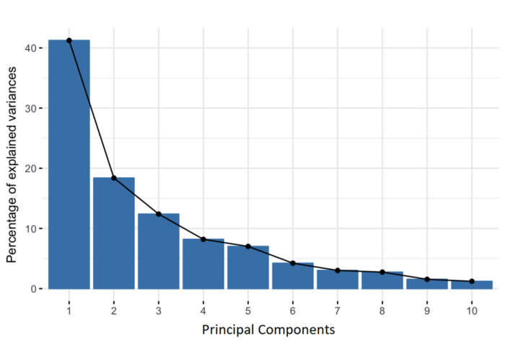
PCA-algorithm
Compute The Eigenvectors And Eigenvalues Of The Covariance Matrix
what is mean by principal component?
Principal components are new variables that are constructed as linear combinations or mixtures of the initial variables.
The new variables (i.e., principal components) are uncorrelated and most of the information within the initial variables is squeezed or compressed into the first components.
10-dimensional data gives 10 principal components, but PCA tries to put maximum possible information in the first component, then maximum remaining information in the second and so on..

Slide 27
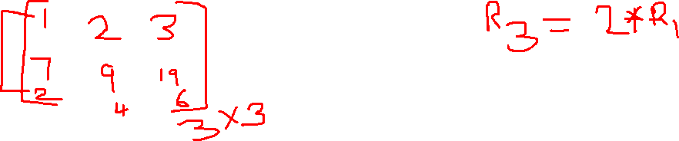
PCA-algorithm
Compute The Eigenvectors And Eigenvalues Of The Covariance Matrix
what is mean by principal component?
Geometrically: Principal components represent the directions of the data that explain a maximal amount of variance.
The lines that capture most information of the data
→Larger the variance carried by a line
→the larger the dispersion of the data points along it
→ and the larger the dispersion along a line, the more the information it has.

Slide 28
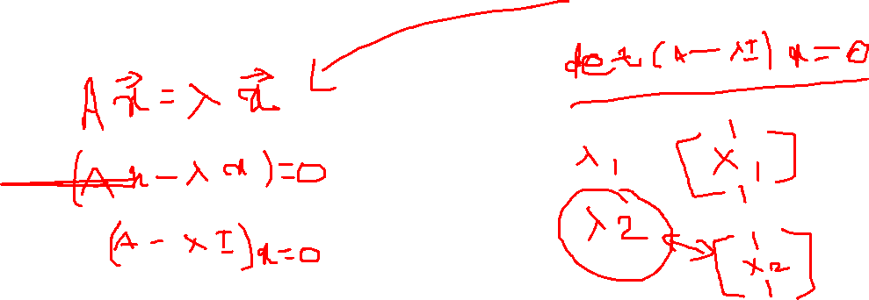
Construction of Principal Components
Eigen Decomposition: Calculate the Eigen value and Eigen vectors
Eigenvectors of the Covariance matrix are actually the directions of the axes where there is the most variance(most information) and that we call Principal Components.
By ranking eigenvectors in order of their eigenvalues, highest to lowest, you get the principal components in order of significance.

Slide 29
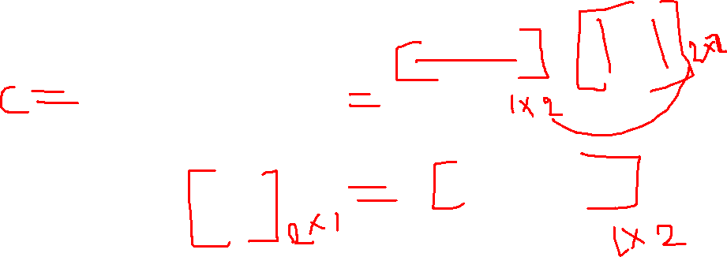
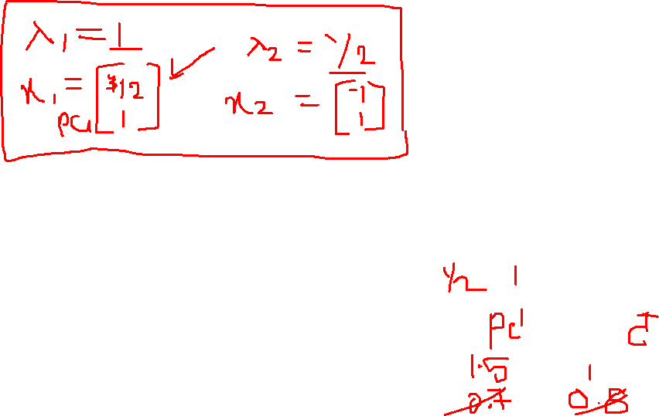
Project The Data Along Principal Components
Calculate the Eigen values and Eigen vectors

Slide 30
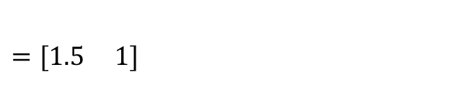
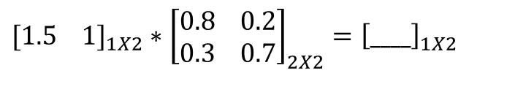
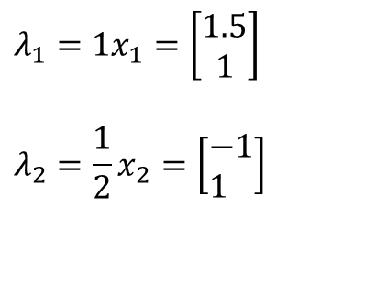
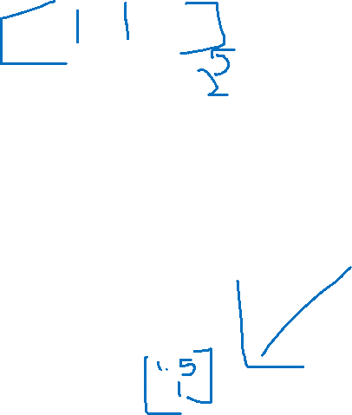
For the largest Eigen value (Lambda=1) calculate the projection
$$λ_{1}=1x_{1}=\left[\begin{aligned}1.5 \\ 1\end{aligned}\right]$$ $$λ_{2}=\frac{1}{2}x_{2}=\left[\begin{aligned}&−1 \\ &1\end{aligned}\right]$$
$$[1.5 1]_{1X2}∗{\left[\begin{aligned}0.8 0.2 \\ 0.3 0.7\end{aligned}\right]}_{2X2}={\left[____\right]}_{1X2}$$
$$=[1.5 1]$$

Slide 31
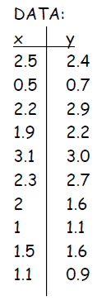
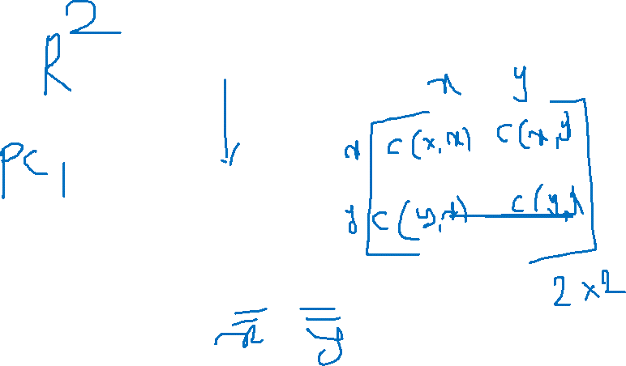

Slide 32
THANK YOU

